Slide 1

UNIVERSITY INSTITUTE OF SCIENCES
Academic Unit V
Bachelor of Engineering
(Computer Science & Engineering)
Biology For Engineers
23SZT148
Electrical Medical Devices
Electroretinogram (ERG)
Electro-occologram (EOG)
Electromyogram (EMG)
DISCOVER . LEARN . EMPOWER

Slide 2
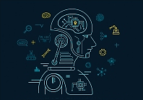

Course Outcome
CO Number | Title | Level
CO1 | Identify the biological concepts from an engineering perspective. | Remember
CO2 | Development of artificial systems mimicking human action. | Understand
CO3 | Explain the basic of genetics that helps to identify and formulate problems | Understand
CO4 | Apply knowledge of measurement system, biomedical recording system and biosensors to excel in areas such as entrepreneurship, medicine, government, and education. | Understand
CO5 | Integrate biological principles for developing next generation technologies
Will be covered in this lecture
https://images.app.goo.gl/5obqqxo93P2UBmdU6

Slide 3
SYLLABUS
Unit-3 | Bio Medical Instrumentation | Contact Hours: 15
Chapter 1 Electrical stimulus and biophysical activity Chapter 2 Biomedical recording system Chapter 3 Tissue Engineering | Electrical stimulus and biophysical activity: Patient, electrical shock and hazards, leakage current, Electrical activity of heart (ECG), Electrical activity of brain (EEG), Electrorentinogram (ERG), Electro-occologram (EOG), Electromyogram (EMG). Biomedical recording systems: Basic Recording system, General consideration for signal conditioners Preamplifiers, Differential Amplifier, Isolation Amplifier, Vectorcardiograph, Phonocardiograph, Other biomedical records, Patient isolation, and accident prevention. Tissue Engineering: Recombinant DNA technology, Stem cell biology & Tissue Engineering.

Slide 4
Biomedical Instrumentation
Biomedical instrumentation and engineering is the application of knowledge and technologies to solve problems related to living biological systems.
It involves diagnosis, treatment and prevention of disease in human.
As the medical field is emerging, the area of Biomedical Engineering is an expanding field.
When the discipline of engineering and medicine interacts, it is called Biomedical Engineering.

Slide 5
Medical Devices
A medical device is any device intended to be used for medical purposes.
Medical devices benefit patients by helping health care providers diagnose and treat patients and helping patients overcome sickness or disease, improving their quality of life.
It involves measurement of biological signals like ECG, EMG, or any electrical signals generated in the human body.
Biomedical Instrumentation helps physicians to diagnose the problem and provide treatment.

Slide 6
Electrical Medical Devices
Electroretinogram (ERG)
Electro-occologram (EOG)
Electromyogram (EMG)

Slide 7
Electroretinogram (ERG)
An electroretinography (ERG) test, also known as an electroretinogram, measures the electrical response of the light-sensitive cells in your eyes.
These cells are known as rods and cones.
Abnormal ERG readings can detect certain abnormalities of these cell layers.
During the test, a medical professional places an electrode on the cornea (at the front of the eye) or on the skin beneath the eye to measure the electrical responses to light of these cells.
They form part of the back of the eye known as the retina.
There are around 120 million rods in the human eye and six to seven million cones.
Electroretinography measures the electrical responses of various cell types in the retina, including the photoreceptors, inner retinal cells, and the ganglion cells.

Slide 8
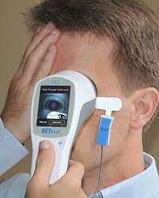
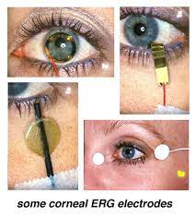
ERG Procedure
ERG is the corneal measure of an action potential produced by the retina when it is stimulated by light of adequate intensity.
ERG is usually well tolerated, painless, and medical professionals can perform ERG even in cooperative children and infants. Occasionally, sedation may be necessary.
The patient assumes a comfortable position either lying down or sitting up.
An eye doctor dilates the patient's eyes with standard dilating eyedrops.
Anesthetic drops are also given. The doctor then props the eyelids open with a speculum and gently places a contact lens electrode or an electrode resembling a fine thread on each eye.
The physician places an additional electrode on the forehead skin.
During an ERG recording session, the patient looks into a bowl displaying different amounts of light.
Retinal cells emit small electrical signals when stimulated by certain types of light.
The ERG machine records the resulting electric signals' amplitude (voltage) and time course.

Slide 9
Types of ERG Testing
Patients’ eyes are stimulated with light and the resulting electrical activity from their retinal cells is measured by skin or corneal electrodes.
Dependent on the type, intensity and color of the light stimulus information on different areas and types of cells can be obtained.
The electrodes measure the electrical activity of the retina in response to light.
The information that comes from each electrode transmits to a monitor where it displays as wave patterns.

Slide 10
Why to do an Electroretinography test?
Your doctor may perform an ERG to determine if you have an inherited or acquired disorder of the retina, such as:
Retinitis pigmentosa, which is a genetic disease causing loss of peripheral and night vision
Macular degeneration, which is a loss of vision due to the death of cells in the macula
Retinoblastoma, which is a cancer of the retina
Retinal separation, which is a detachment of the retina from the back of the eyeball
Cone rod dystrophy (CRD), which is vision loss due to impaired cone and rod cells
An ERG may also help your doctor assess your need for retinal surgery or other types of eye surgery, such as the removal of cataracts.
There are retinal diseases in which specific cells are missing or weak at birth, while other abnormalities are acquired over time.

Slide 11
Applications of Electroretinography
Determining the functional status of the retina with different types of ERG testing allows clinicians and researchers to evaluate patients for retina-related conditions, reliably monitor retinal function over time, and evaluate the efficacy of retinal treatments.
Evaluation of visual function in infants and children.
Electroretinography has an impressive range of human and animal applications, for both clinical and research uses.
To determine presence or absence of retinal function.
To evaluate progression of retinal degeneration.
To confirm diagnosis of a particular disease (dystrophies).
For early detection of toxic retinopathies.
Assisting in diagnosing the retinal conditions in which clinical finding don’t match with visual complaints (unexplained visual loss).

Slide 12
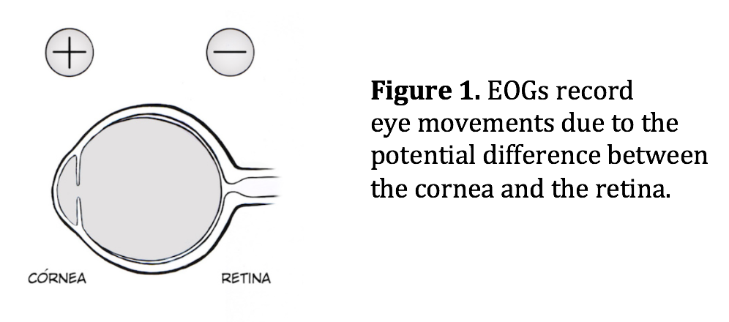
Electrooculogram (EOG)
Electrooculography (EOG) is a technique for measuring the corneo-retinal standing potential that exists between the front and the back of the human eye.
The electro-oculogram (EOG) investigates abnormalities of the outermost layer of the retina, the retinal pigment epithelium.
Electro-oculography is the recording of the bio-potentials generated by the movement of the eyeball.
The EOG potentials are picked up by small surface electrodes placed on the skin near the eye.

Slide 13
Principle of EOG
The electrooculogram (EOG) is an electrophysiologic test that measures the existing resting electrical potential between the cornea and Bruch's membrane.
The difference of electrical potential of the anterior and posterior part of the eyeball is called the standing potential.
The EOG is used to assess the function of the pigment epithelium.
During dark adaptation, resting potential decreases slightly and reaches a minimum (“dark trough”) after several minutes.
When light is switched on, a substantial increase of the resting potential occurs (“light peak”), which drops off after a few minutes when the retina adapts to the light.
The ratio of the voltages (i.e. light peak divided by dark trough) is known as the Arden ratio.
Standing potential indirectly measures the transepithelial potential (TEP) of the retinal pigment epithelium (RPE).
TEP is the difference of membrane potential of basolateral and apical membranes of RPE.
The mean transepithelial voltage of bovine Retinal pigment epithelium is 6 millivolts (mV).
Notes:
The EOG was described and named by Elwin Marg in 1951.
Clinical applications were described first by Geoffrey Arden in 1962, who realized that the most valuable information was the comparison of the amplitudes under light and dark-adapted states (the Arden ratio).

Slide 14
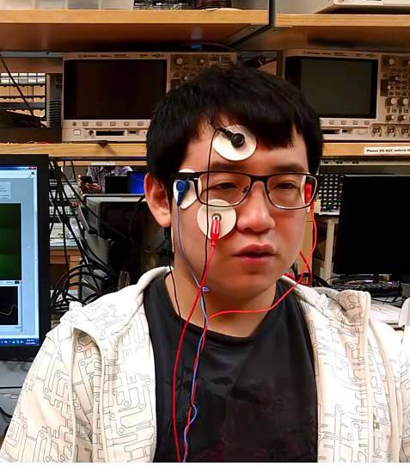
Testing process of EOG
The patient is told to remain still other than moving his/her eyes back and forth.
The patient should be dilated.
Four recording skin electrodes (silver-silver chloride or gold-disk) are placed at the medial and lateral canthi of both eyes, and the grounding electrode is placed on the forehead (The ground electrode/reference electrode is usually positioned over bony body structures).
The patient should be in stable indoor lighting for at least 30 min before the test.
Strong retinal illumination including retinal imaging (fluorescein angiogram, fundus photography and others) and indirect ophthalmoscopy should be avoided during this period.
For instance when an EEG is taken from the Occipital region of the brain, EOG signal will cause the maximum amount of noise.
Notes:
Dilated: to enlarge, widen, or cause to expand dilate his pupils with atropine the drug dilates peripheral arteries.
The ground electrode is usually positioned over bony body structures

Slide 15
Applications of EOG
EOG is a very useful tool in diagnosing hereditary macular diseases such as Best Disease.
In conjunction with an ERG, it can be useful in diagnosing various progressive retinal disorders.
EOG has other various applications including brain and sleep studies, assistive technology, sleep and mental disorder diagnosis, and HMIs.
EOG along with electroencephalogram (EEG) and electromyogram (EMG) are used for patients suffering from neural system disorders such as progressive neuro-motor degenerative diseases.
Understanding the disease states that affect the EOG make it easier to interpret the results.
The electro-oculogram (EOG) investigates abnormalities of the outermost layer of the retina, the retinal pigment epithelium.
One possible application: artificial eyes and recreation of "natural" eye movement.
A team of engineers from the University of Alberta designed the first robotic eye implant to mimic the movement of a real human eye.
The robotic eye detects and follows the movement of the remaining natural eye.

Slide 16
Electromyogram (EMG)
Electromyography (EMG) is a diagnostic procedure that evaluates the health condition of muscles and the nerve cells that control them.
These nerve cells are known as motor neurons. They transmit electrical signals that cause muscles to contract and relax.
Muscle contraction due to a change in the relative sliding of thread-like molecules or filaments: Actin and Myosin
Filament sliding is triggered by electrical phenomenon called ACTION POTENTIAL (AP)
The recording of muscle APs is called electromyography (EMG),
The record is known as an electromyogram.
EMG results can reveal nerve dysfunction, muscle dysfunction or problems with nerve-to-muscle signal transmission.
An EMG translates these signals into graphs or numbers, helping doctors to make a diagnosis.

Slide 17
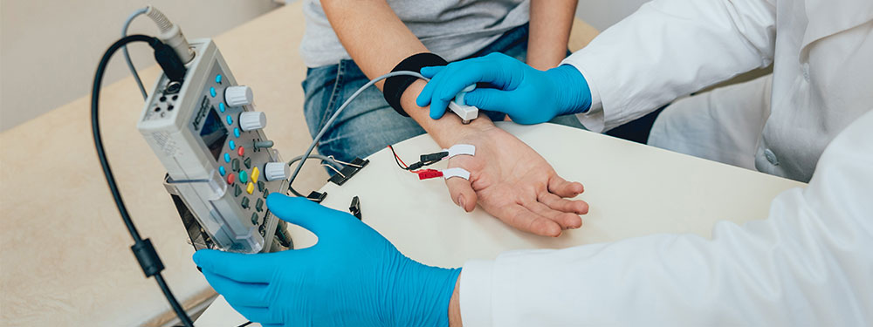
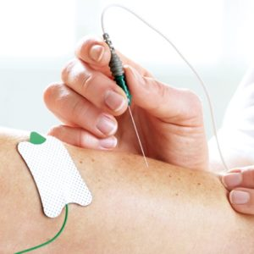
PROCEDURE OF EMG
There are two components to an EMG test: the nerve conduction study and needle EMG.
It involves placing several small sensors called surface electrodes on the skin (usually in the area where you’re experiencing symptoms) to assess the ability of the motor neurons to send electrical signals.
The second part of the EMG procedure, known as needle EMG, also uses sensors to evaluate electrical signals.
The sensors are called needle electrodes (they are made up of stainless steal), and they’re directly inserted into muscle tissue to evaluate muscle activity when at rest and when contracted.
The nerve conduction study is the first part of the procedure.
An EMG uses tiny devices called electrodes to translate these signals into graphs, sounds or numerical values that are then interpreted by a specialist.
As the muscle is contracted more forcefully, more and more muscle fibers are activated, producing action potentials (50μV-5mV).
Typical range of EMG can be 0.1-0.5 mV.
Subject is GROUNDED by placing an electrode in an inactive region of body
Surface Electrodes
Needle Electrodes

Slide 18
What can be learned from an EMG
Time course of muscle contraction
Contraction force
Coordination of several muscles in a movement sequence
These parameters are DERIVED from the amplitude, frequency, and change of these over time of the EMG signal
Field of Ergonomics: from the EMG conclusions about muscle strain and the occurrence of muscular fatigue can be derived as well
Intraoperative electromyography (EMG) provides useful diagnostic and prognostic information during spine and peripheral nerve surgeries.
It can be used to monitor nerve roots during spine surgeries, the facial nerve during cerebellopontine angle surgeries, and peripheral nerves during brachial plexus exploration and repair.
The use of EMG during surgery is to monitor the neuromuscular function with the neuromuscular blocking drug during general anesthesia.

Slide 19
WHY EMG DONE
Your doctor may perform an EMG if you’re experiencing symptoms that may indicate a muscle or nerve disorder. Some symptoms include:
Tingling
Numbness
Muscle weakness
Muscle pain or cramping
Paralysis
Involuntary muscle twitching (or tics)
EMG results can help the doctor diagnose muscle disorders, nerve disorders, and disorders affecting the connection between nerves and muscles.
Possible causes could include:
Muscle disorders, such as muscular dystrophy
Disorders that affect the ability of the motor neuron to send electrical signals to the muscle, such as myasthenia gravis
Radiculopathies
Peripheral nerve disorders that affect the nerves outside the spinal cord

Slide 20
REFERENCES
John G Webster, “Medical Instrumentation – Application and Design”, 4th ed., John Wiley and Sons, 2007.
Leslie Cromwell, Fred. J. Weibell, Erich. A. Pfeiffer, “Biomedical Instrumentation & Measurements, 2nd ed., Pearson Education., 2001.
Ryaby J.T. (2005) Biophysical Stimulation Using Electrical, Electromagnetic, and Ultrasonic Fields. In: Lieberman J.R., Friedlaender G.E. (eds) Bone Regeneration and Repair. Humana Press. https://doi.org/10.1385/1-59259-863-3:291
C.B.Powar, 2010.Cell Biology.5th Ed,Himalyan Publishing House.
Leshie Cromwell, Fred.J. Weibell and Erich.A.Pfeiffer. 2003. Biomedical instrumentation and measurements. 2nd edition, PHI.
John G. Webster 1998. Medical Instrumentation: Applications and Design, 3rd edition, Jon Wiley and Sons, New York.
Jeremy M. Berg, John L. Tymoczko and Lubert Stryer. 2006. “Biochemistry,” 6th Ed. W.H. Freeman and Co. Ltd.
Robert Weaver. 2012 “Molecular Biology,” 5th Edition, MCGraw-Hill.
Jon Cooper, , 2004. “Biosensors A Practical Approach” Bellwether Books.
Martin Alexander, 1994 “Biodegradation and Bioremediation,” Academic Press.

Slide 21
THANK YOU

